Slide 1

Estructura de Datos ||
Jonathan López Londoño
jlopezl@uao.edu.co
315 926 5443

Slide 2
Stacks
Most common example about stacks in programming is:
Imagine that you have a stack of dinner plates to wash after you have dined with your family, and you are responsible to wash this stack of plates.
How would you start it?
Well, the obvious answer is from the top

Slide 3
Stacks
A structure of sequential and ordered elements.
Is based on the principle of last in first out (LIFO). Always the last element that we add, will be the first that we take out

Slide 4
Using Stacks
The history of Web browsers. Each new page that we visit is mounted on top of the previous one and they generate a stack of records, on which we can go back one by one.
Stacks are useful when we need a data structure that we will end up displaying chronologically from most to least recent (such as a list of the latest tweets or articles). In this case, the most recently entered data is the first one that we will retrieve and display.

Slide 5
Stacks Methods
A stack must have methods that allow adding new elements, removing them and reviewing them (one or more).
We can make our own implementation and call these methods in any way.
There is an agreed convention of using the following definitions:
push: Adds a new value to the stack, placing it at the bottom of it.
pop: Returns the last value entered on the stack, popping it off the stack.
peek: Returns the last value entered on the stack, without removing it from it.
isEmpty: Returns true if the stack is empty.
size: Returns the number of elements in the stack.
print: Prints the contents of the stack.

Slide 6
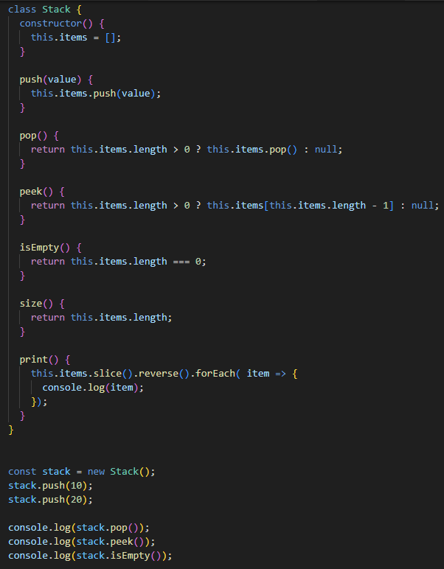
How to implement Stacks?
Peek is the only one method we need to implement, the others come from Prototype in JavaScript

Slide 7
CHALLENGE 08
Create and handle new stack of books. Every book must have its Name, ISBN, Author and Editorial
Fill the stack with some mock data
Create a new project in react, and implements a new screen with a form to create a new book, then add the book to the stack
Print the books stack in screen

